Slide 1

Kce college of engineering and Management

Slide 2
Project Title Library Book Issue Management System
Project Made by:
1)Yash G Patil (67)
2) Aman P Wagh (68)
3) Vanshika H Zawar (69)

Slide 3
Index
1) Introduction
2) Aim to develop the system
3) Output of the Project
4) Skills developed to learn this project
5) Conclusion

Slide 4

Introduction

Slide 5
A Library Book Management System is a software application designed to manage and automate various tasks related to a library's operations. It handles the process of checking in and out books, tracking borrowed items, managing inventory, and maintaining member records. These systems enhance the efficiency of librarians, offering better cataloging, organization, and control over library resources like books, magazines, and digital content.
Catalog Management: Organizing and maintaining records of all available resources.
Member Management: Tracking the borrowing history and details of members.
Automated Check-In/Check-Out: Streamlining the borrowing and returning process.
Late Fees and Reminders: Managing fines and sending notifications to users for
overdue items.
Resource Reservation: Enabling members to reserve books in advance.

Slide 6
Aim to develop the Library Book Management System
Streamlining Book Tracking: Automates check-ins, check-outs, and book inventory updates.
Member Management: Keeps records of library members, including borrowing history and due dates.
Efficiency in Administration: Reduces manual work, increasing the productivity of library staff.
Enhanced User Experience: Allows users to search, reserve, or renew books easily.
Report Generation: Helps librarians generate detailed reports on book usage, fines, and membership data.

Slide 7
Automating Book Management: The LMS tracks book availability, manages check-ins/
check-outs, and ensures seamless inventory management.
Improving User Experience: With features like user authentication, profile management, and book search, it enhances the experience for library members.
Maintaining Member Records: The system helps to manage user data, borrowing history, and reservations, reducing errors.
Facilitating Reporting: Generate reports for library operations, including overdue books, inventory status, and member activity.

Slide 8
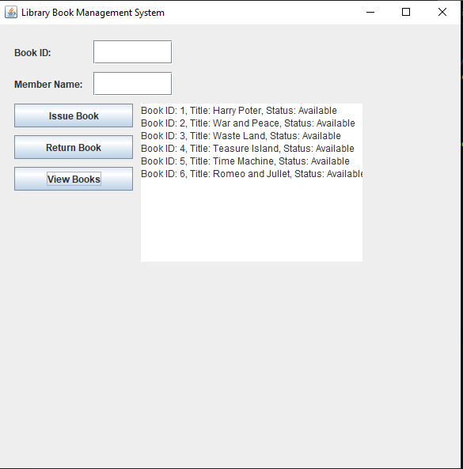
Output of the Project

Slide 9
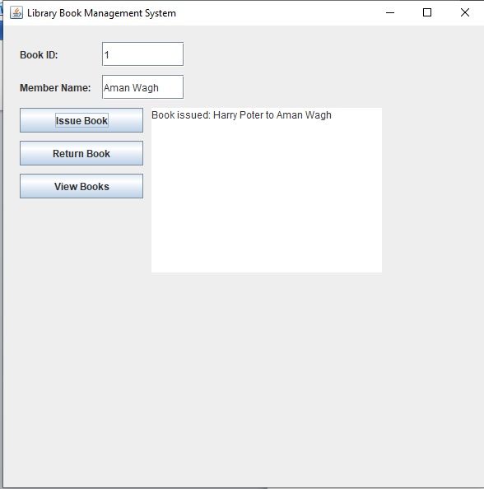

Slide 10
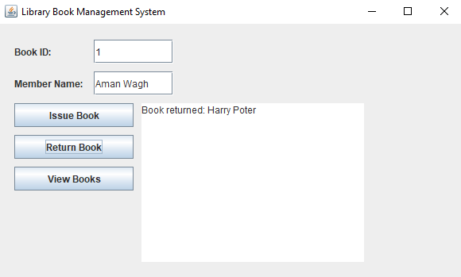

Slide 11
Code of the project
import javax.swing.*;
import java.awt.event.*;
import java.util.*;
class Book {
int id;
String title;
String author;
boolean isIssued;
public Book(int id, String title, String author) {
this.id = id;
this.title = title;
this.author = author;
this.isIssued = false;
}
}
class Library {
List<Book> books = new ArrayList<>();
Map<Integer, String> issuedBooks = new HashMap<>();
// Add books to library
public void addBook(Book book) {
books.add(book);
}

Slide 12
// Issue a book
public void issueBook(int bookId, String memberName, JTextArea displayArea) {
for (Book book : books) {
if (book.id == bookId && !book.isIssued) {
book.isIssued = true;
issuedBooks.put(bookId, memberName);
displayArea.setText("Book issued: " + book.title + " to " + memberName);
return;
}
}
displayArea.setText("Book not available or already issued.");
}
// Return a book
public void returnBook(int bookId, JTextArea displayArea) {
if (issuedBooks.containsKey(bookId)) {
for (Book book : books) {
if (book.id == bookId && book.isIssued) {
book.isIssued = false;
issuedBooks.remove(bookId);
displayArea.setText("Book returned: " + book.title);
return;
}
}
} else {
displayArea.setText("Book was not issued.");
}
}

Slide 13
public class LibraryApp extends JFrame implements ActionListener {
Library library;
JTextField bookIdField, memberField;
JTextArea displayArea;
JButton issueButton, returnButton, viewButton;
public LibraryApp() {
library = new Library();
library.addBook(new Book(1, "Harry Poter", "J. K. Rowling"));
library.addBook(new Book(2, "War and Peace", "Leo Tolstoy"));
library.addBook(new Book(3, "Waste Land", "T.S Eliot"));
library.addBook(new Book(4, "Teasure Island", "R.L Stevenson"));
library.addBook(new Book(5, "Time Machine", "H.G Wells"));
library.addBook(new Book(6, "Romeo and Jullet", "Willam Shakesphere"));
// Creating the frame
setTitle("Library Book Management System");
setSize(600, 600);
setLayout(null);
setDefaultCloseOperation(JFrame.EXIT_ON_CLOSE);

Slide 14
JLabel bookIdLabel = new JLabel("Book ID:");
bookIdLabel.setBounds(20, 20, 100, 30);
add(bookIdLabel);
JLabel memberLabel = new JLabel("Member Name:");
memberLabel.setBounds(20, 60, 100, 30);
add(memberLabel);
// Text Fields
bookIdField = new JTextField();
bookIdField.setBounds(120, 20, 100, 30);
add(bookIdField);
memberField = new JTextField();
memberField.setBounds(120, 60, 100, 30);
add(memberField);
// Buttons
issueButton = new JButton("Issue Book");
issueButton.setBounds(20, 100, 150, 30);
issueButton.addActionListener(this);
add(issueButton);
returnButton = new JButton("Return Book");
returnButton.setBounds(20, 140, 150, 30);
returnButton.addActionListener(this);
add(returnButton);
viewButton = new JButton("View Books");
viewButton.setBounds(20, 180, 150, 30);
viewButton.addActionListener(this);
add(viewButton);

Slide 15
// Text Area to display output
displayArea = new JTextArea();
displayArea.setBounds(180, 100, 280, 200);
displayArea.setEditable(false);
add(displayArea);
setVisible(true);
}
@Override
public void actionPerformed(ActionEvent e) {
int bookId;
String memberName;
// Issue Book
if (e.getSource() == issueButton) {
try {
bookId = Integer.parseInt(bookIdField.getText());
memberName = memberField.getText();
library.issueBook(bookId, memberName, displayArea);
} catch (NumberFormatException ex) {
displayArea.setText("Please enter a valid book ID.");
}
// Return Book
} else if (e.getSource() == returnButton) {
try {
bookId = Integer.parseInt(bookIdField.getText());
library.returnBook(bookId, displayArea);
} catch (NumberFormatException ex) {
displayArea.setText("Please enter a valid book ID.");
}
// View Books
} else if (e.getSource() == viewButton) {
library.viewBooks(displayArea);
}
} public static void main(String[] args) {
new LibraryApp();
public static void main(String[] args) {
new LibraryApp();
}
}

Slide 16
Skills Develop to learn this Project
Programming Languages: Proficiency in languages like Java, Python, or JavaScript is important for building both the backend and frontend of the system.
Database Management: Knowledge of SQL and working with database systems like MySQL is necessary for managing and storing the library's data effectively.
Web Development: Skills in HTML, CSS, and JavaScript are critical for designing a user-friendly web interface.
Software Development Lifecycle: Understanding how to structure, develop, test, and deploy software systems is key.
Problem-Solving: Developing a flexible and scalable system requires logical thinking and problem-solving abilities .

Slide 17
Conclusion
Developing a Library Book issue Management System requires a wide range of data of books and information about the book and how to make a real time project using the information and data available to us and make a better and efficient a working program or website using it in real time to manage the book in the issue order or manage it in the library makes it easy when you have a perfect record of work in a proper place which make it efficient to handle

Slide 18


